Slide 1
General Information on
Doctoral Studies

Slide 2
ACADEMIC ADMINISTRATION: Who to contact?
Doctoral and Habilitation Centre (DHC)
Gödöllő Campus
Mónika HAJDÚ
Head of DHC
torokne.hajdu.monika@uni-mate.hu
Edit SIMA DOLÁNYI
International coordinator
simane.dolanyi.edit@uni-mate.hu
Zsuzsanna TASSY
international coordinator
tassy.zsuzsanna@uni-mate.hu
Buda Campus
Zsuzsanna TASSY
international coordinator
tassy.zsuzsanna@uni-mate.hu
Kaposvár Campus
Katalin LACZKÓ
international coordinator
laczko.lorantne@uni-mate.hu
Keszthely (Festetics Campus)
Mónika HAJDÚ
torokne.hajdu.monika@uni-mate.hu

Slide 3
KEY SOURCES OF INFORMATION
HOMEPAGES: https://en.uni-mate.hu/ and https://doktori.hu/
FACEBOOK: join „International students at MATE (former SZIU)” and „International PhD students MATE (former SZIU)” groups
SH/SCYP contracts for SH/SCYP scholarship holders
Rules and procedures: Doctoral Rules at MATE (https://en.uni-mate.hu/)
Official Hungarian site of scientific publications: MTMT Registration is compulsory for PhD students (https://www.mtmt.hu/)
Info: MATE libraries or mtmt@uni-mate.hu

Slide 4
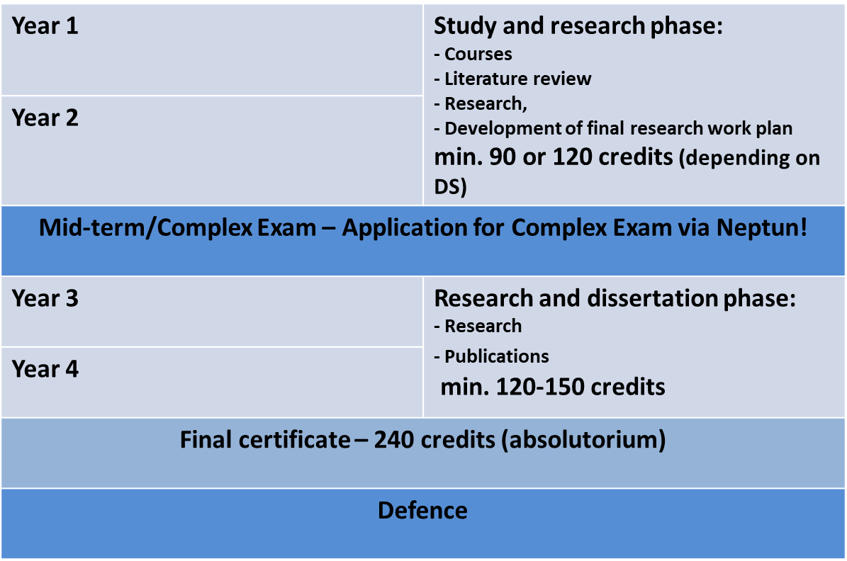
PHD PROGRAMME STRUCTURE

Slide 5
MID-TERM (COMPLEX) EXAM 1.
Theoretical part
2 subjects/topics in connection with the student’s reseacrh field (usually from the list of courses)
Thesis related part
Scholars have to report on the progress of literature review, project planning and initial research activities

Slide 6
MID-TERM (COMPLEX) EXAM 2.
Registration required (via Neptun)
Supervisor’s recommendation necessary
Public event
Exam Committee: minimum 3 members
The 2 parts are evaluated individually
Evaluation: passed / fail
Descriptive assessment will be issued on the spot
Both parts have to be successful
The theoretical part can be resit once. If the thesis part fails, the programme is terminated.

Slide 7
TERMS OF PUBLIC DEFENSE
successful mid-term exam
240 credits = obtaining the final certificate (absolutorium)
documentation of the independent scientific work according to the DS rules (publication)
Defending the results and thesis in a public debate (public defence)

Slide 8
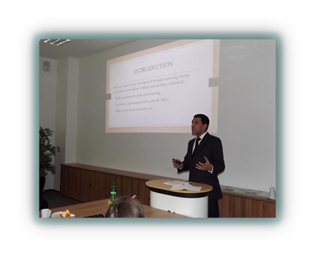
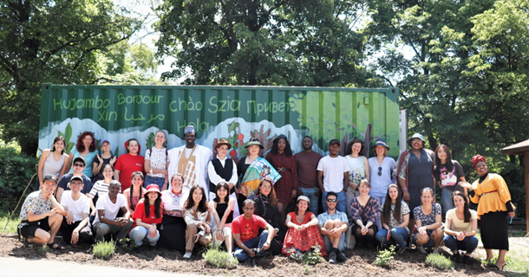
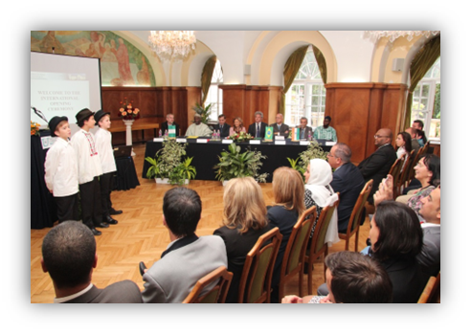
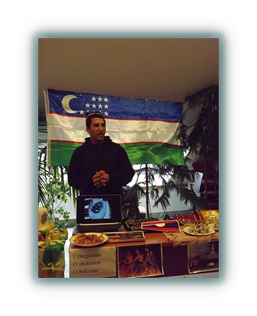
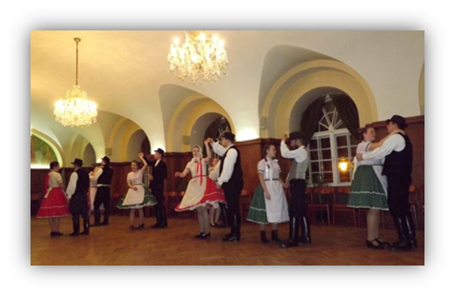
PROGRAMS for INTERNATIONAL STUDENTS
Orientation Week
Researcher’s Night
International Opening Ceremony
Cultural events (international dinner, sports competitions etc.)
Plant, farm visits
Participation in scientific conferences
Community garden in Gödöllő (grow your own veggies and herbs): https://www.facebook.com/SZIA-Agroecological-Garden-of-MATE-112538517117241/
EU projects (e.g. E³UDRES³): https://en.uni-mate.hu/e%C2%B3udres%C2%B2-european-university-alliance

