Slide 1

General information on doctoral studies
Gödöllő and Buda Campus
September, 2024

Slide 2


Main contacts
MATE, 2100 Gödöllő, Páter Károly utca 1. ,
Tel.: 06-28-522-000,
Fax: 06-28-410-804,
E-mail: phd@uni-mate.hu
AZ ELŐADÁS CÍME, KÉT SORBAN
KÉSZÍTETTE: SAMPLE TAMÁS

Slide 3


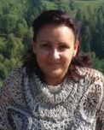
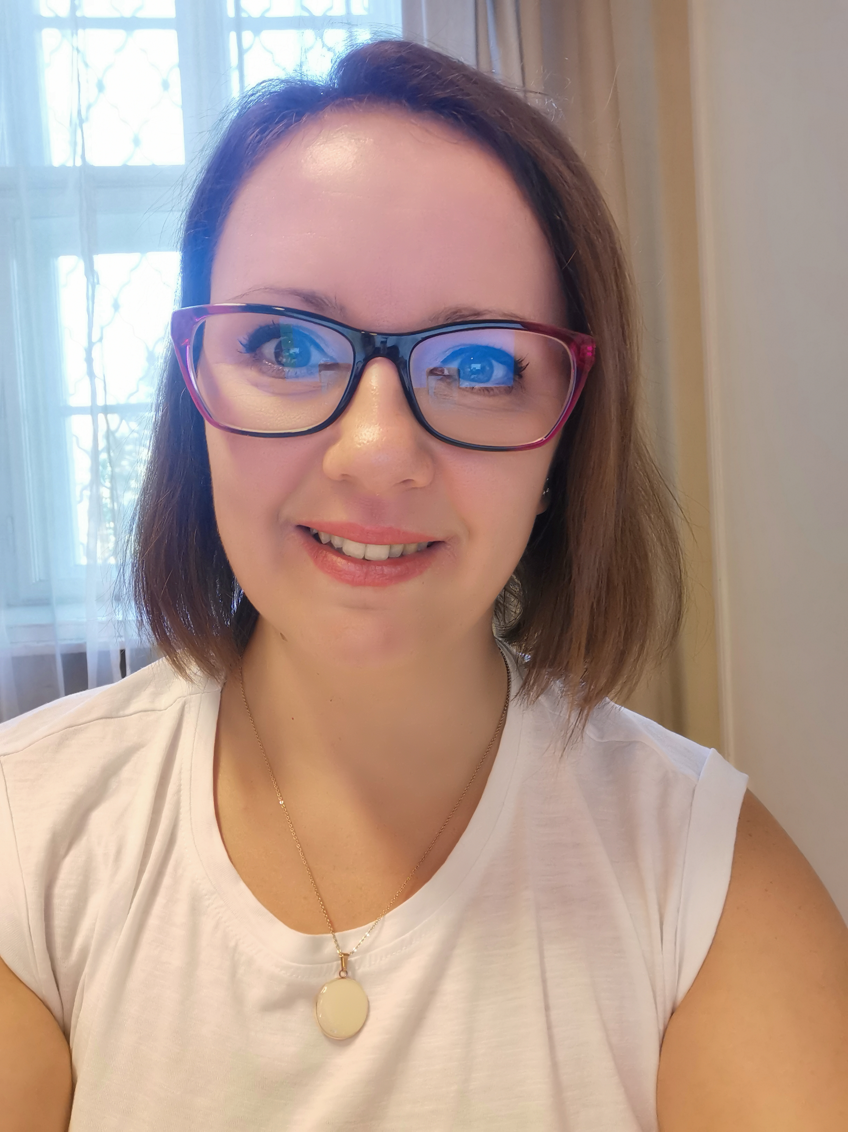
Administration: Who to contact (Gödöllő and Buda)?
Colleagues at DHC
Mónika Hajdú
Head of DHC
Doctoral and Habilitation Centre, Gödöllő
Edit Sima-Dolányi
International coordinator (educational)
Doctoral and Habilitation Centre, Gödöllő, Buda

Slide 4
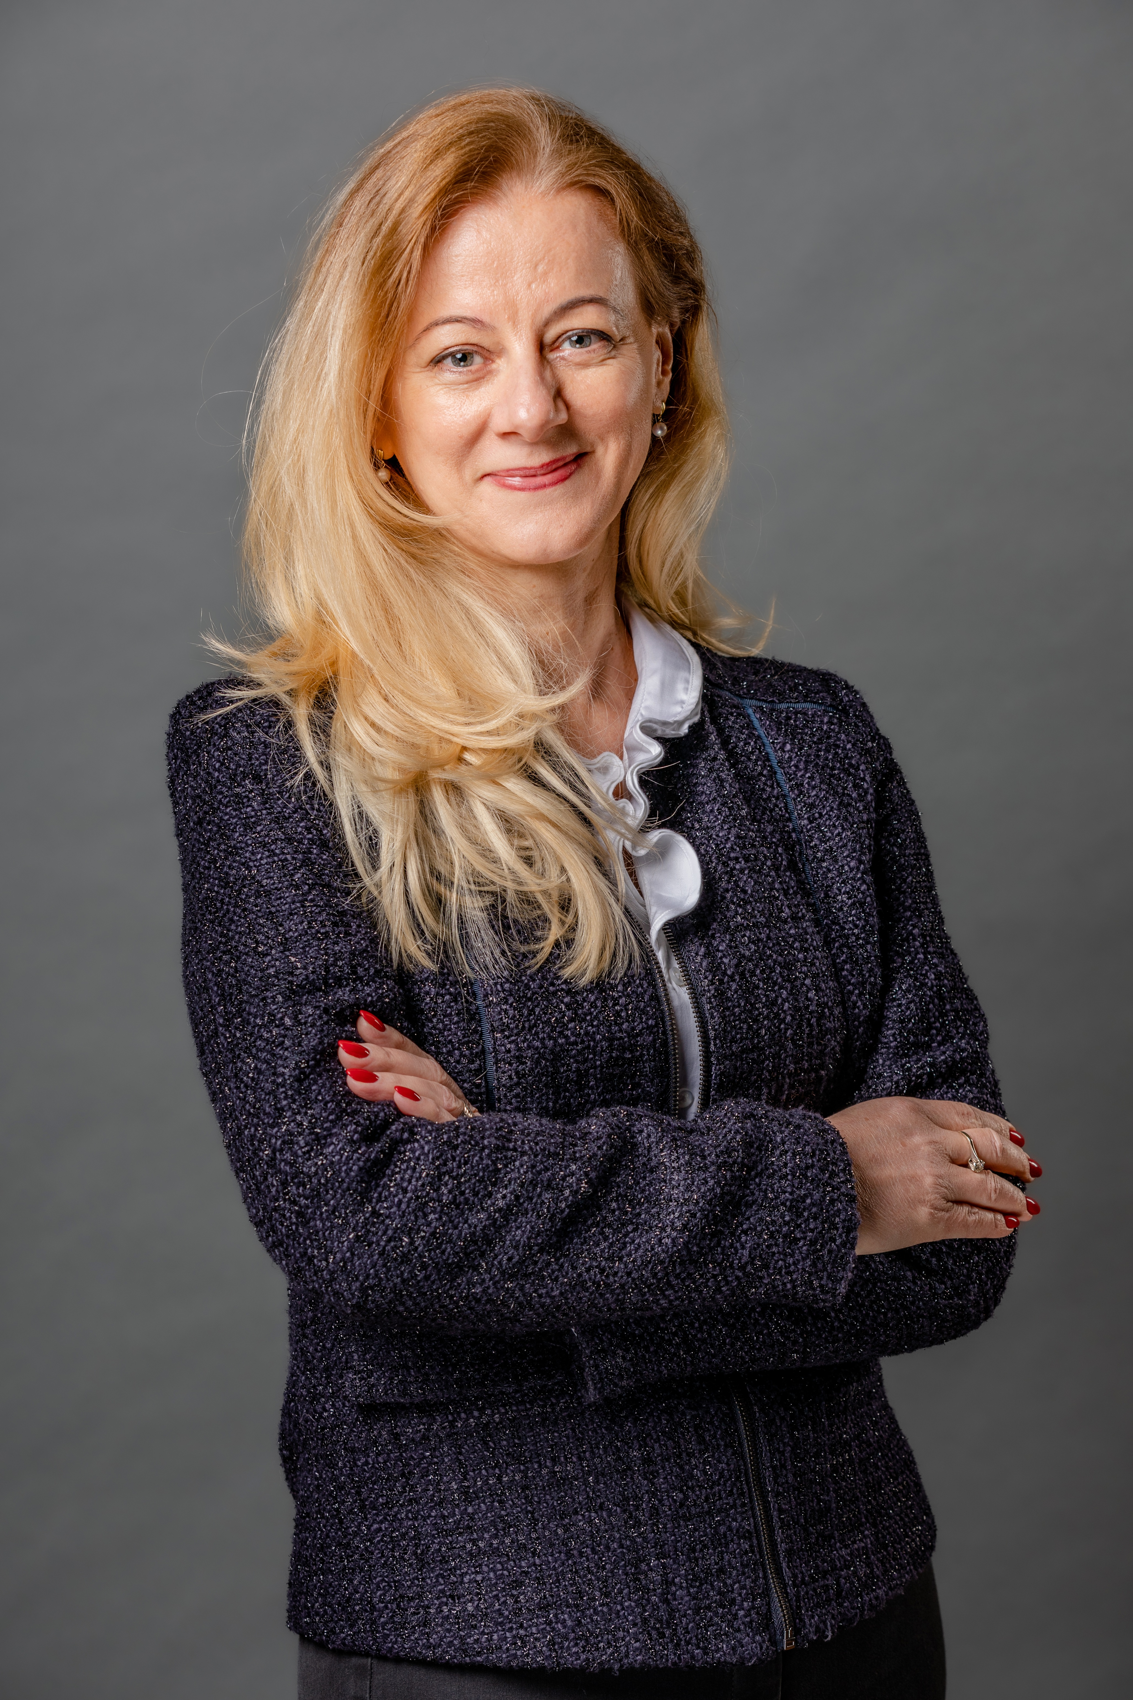
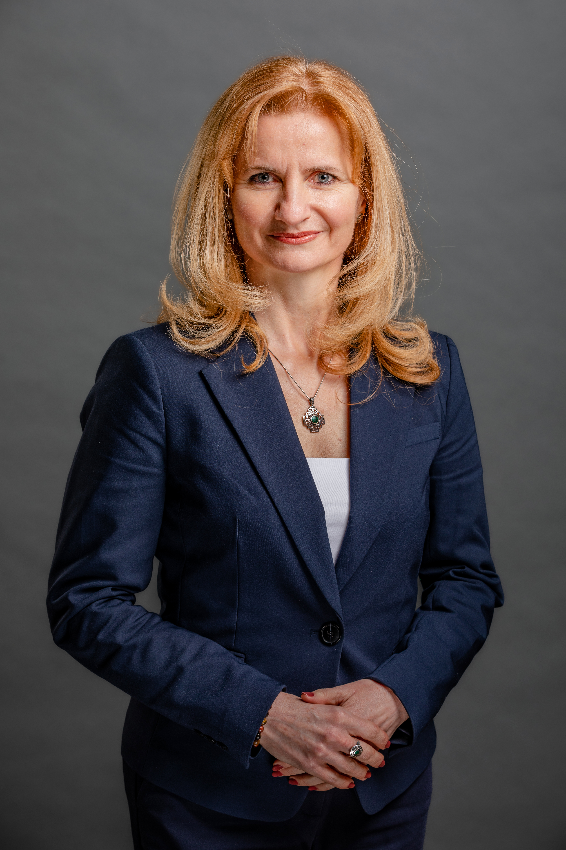
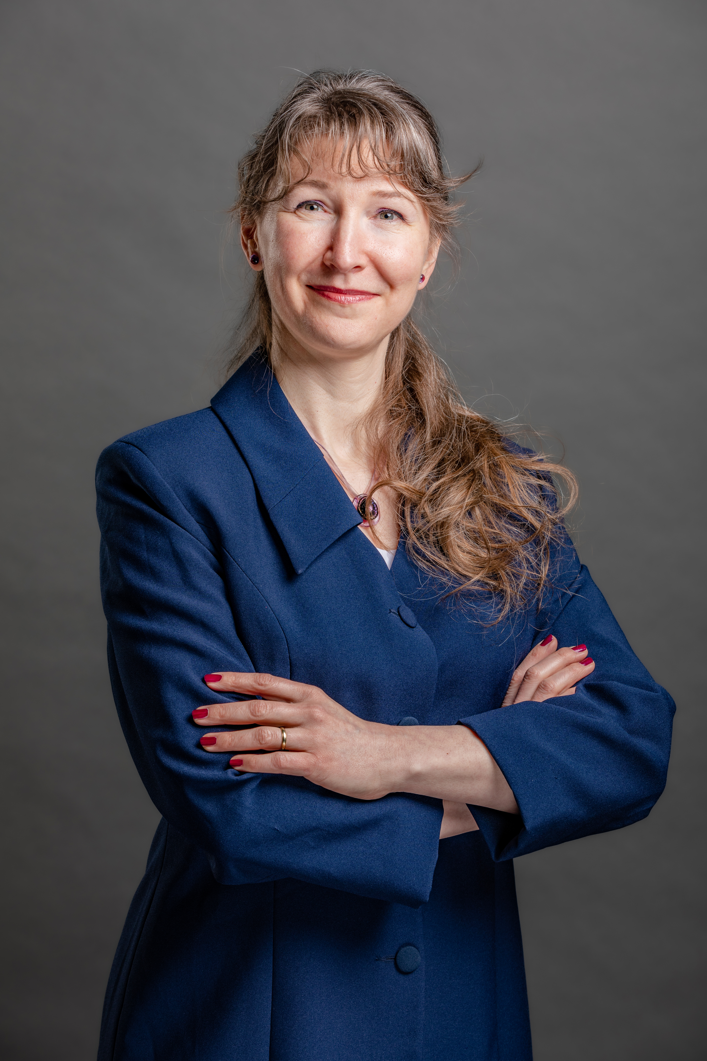
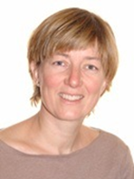
Colleagues at International Centre (IC)
Dr. Zsuzsanna Tarr
Head of Center for International Education
Csilla Kánai
Stipendium Hungaricum (SH) Institutional Coordinator
Judit Tallárom-Czingili
Student Services Coordinator – non-educational issues (SH, SCYP, DFP, FAO, MISP, Self-finance)
Zsuzsanna Tassy
International coordinator– non-educational issues (SH,
Diaspora, MISP)

Slide 5
Colleagues at Dormitory (Gödöllő and Buda)
Beáta Kárpáti
Student coordinator
Dormitory, Gödöllő
Orsolya Horváthné Horváth
Student coordinator
Dormitory, Gödöllő
Ildikó Fedor
Head of Dormitory
Somogyi Imre Dormitory, Buda

Slide 6
Key sources of information
WEBSITES
https://en.uni-mate.hu/
https://phd.uni-mate.hu/
https://doktori.hu/
FACEBOOK
Join „International students at MATE (former SZIU)” and
„International PhD students MATE (former SZIU)” groups
RULES AND PROCEDURES
https://phd.uni-mate.hu/regulations

Slide 7
Structure of PhD programme
Year 1 | Study and reseach phase: Courses Literature review Research Development of final research work plan 90-120 credits (depends on the Doctoral School)
Year 2
Mid-term/Complex Exam – Application for Complex Exam via NEPTUN!
Year 3 | Research and dissertation phase: Research Publications 120-150 credits
Year 4
Final certificate – 240 credits (absolutorium) Home defense
Final defense – Application for final defense via NEPTUN!

Slide 8
Mid-term (Complex) exam
„theoretical exam part”
2 subjects, defined for the students
(usually from the list of courses)
„thesis related part”
Scholars have to report on the progress of literature review, and project planning and initial research activities
Registration required (via Neptun)
Supervisor’s recommendation necessary
It is a public event
Exam Committee: minimum 3 members
The chair is a professor
All members hold PhD degree
Supervisor present, but not member, does not vote
The 2 parts are evaluated individually
Evaluation: passed / fail
Descriptive assessment will be issued on the spot
Both parts have to be successful
The theorexam can be resit once. If the second resit fails the programme is terminated.

Slide 9
Terms of PhD degree
successful mid-term exam,
240 credits
obtaining the final certificate (absolutorium),
documentation of the independent scientific work according to the DS rules (publication)
Defending the results and thesis in a public discussion (defence)

Slide 10
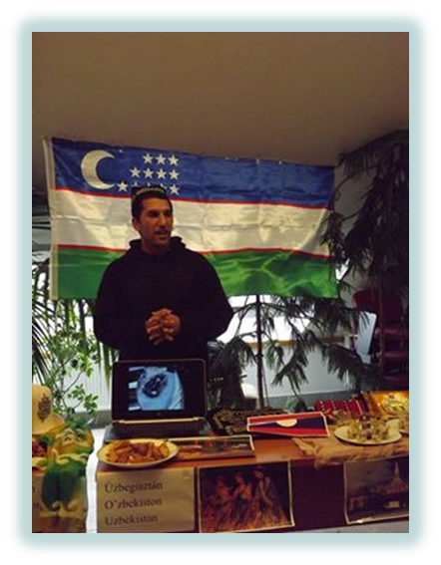
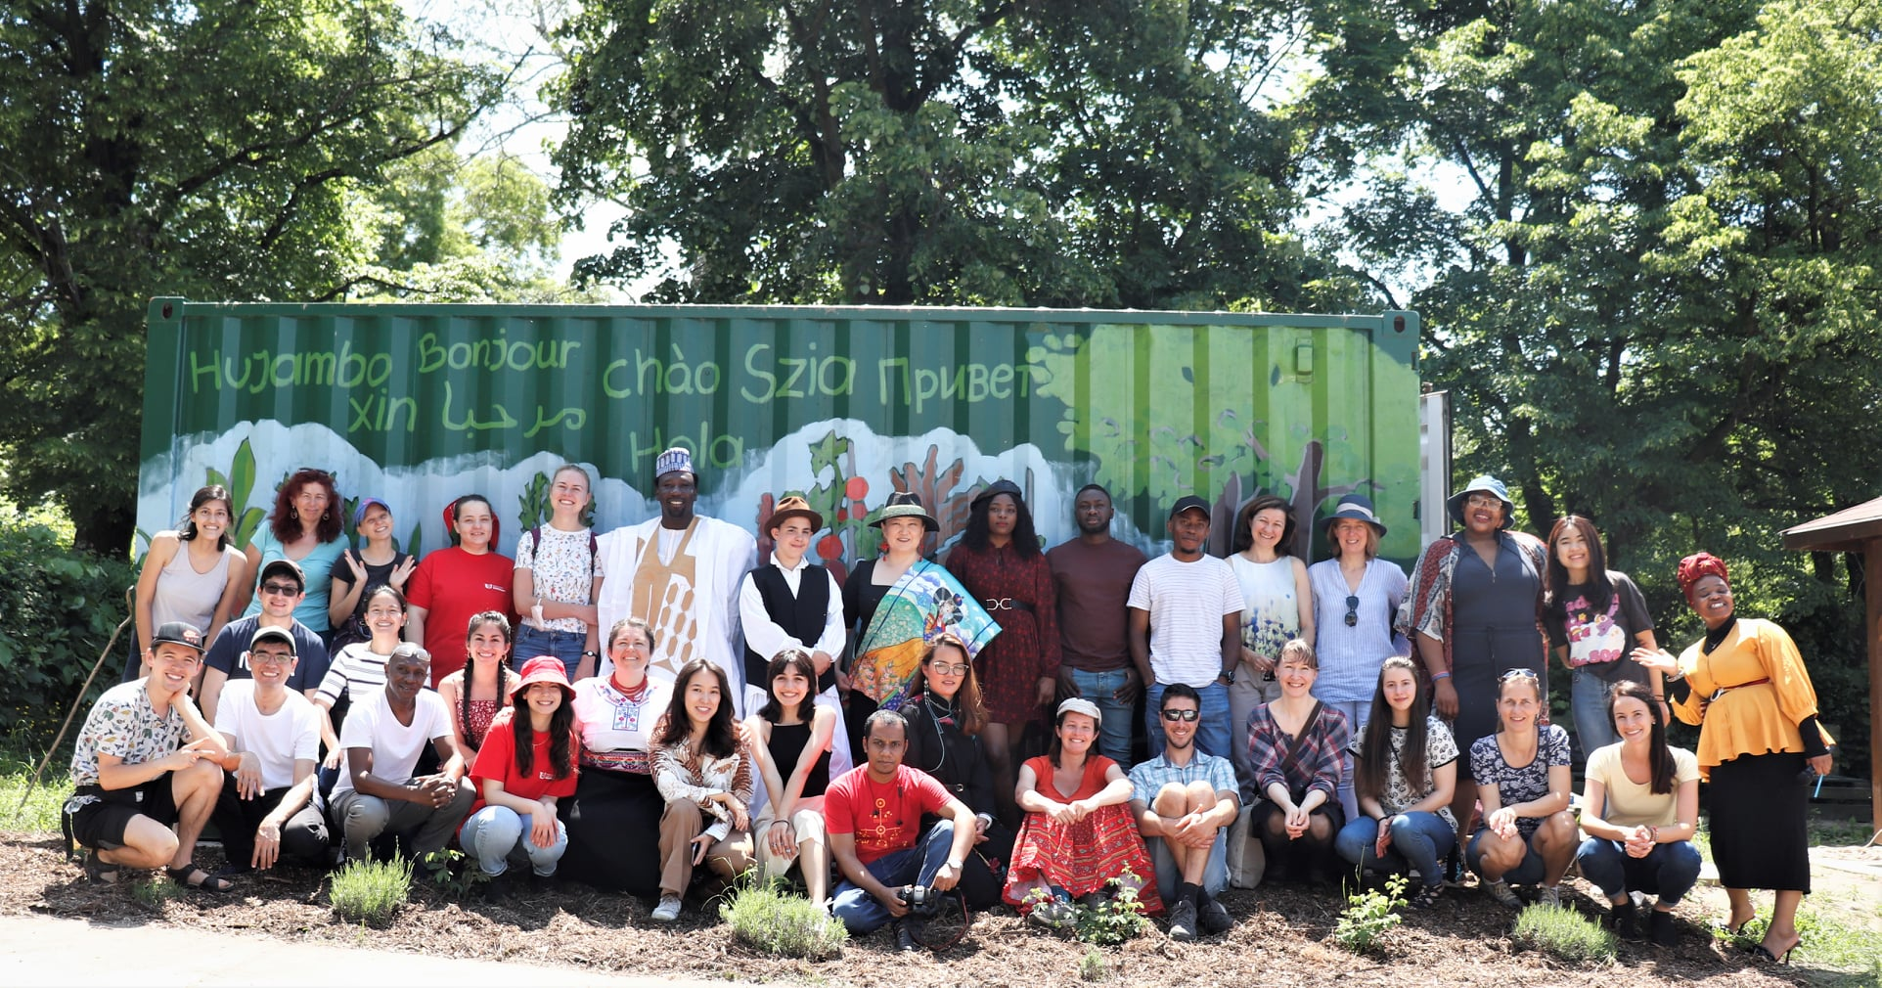
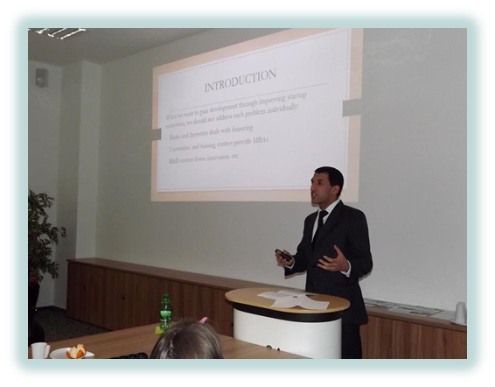
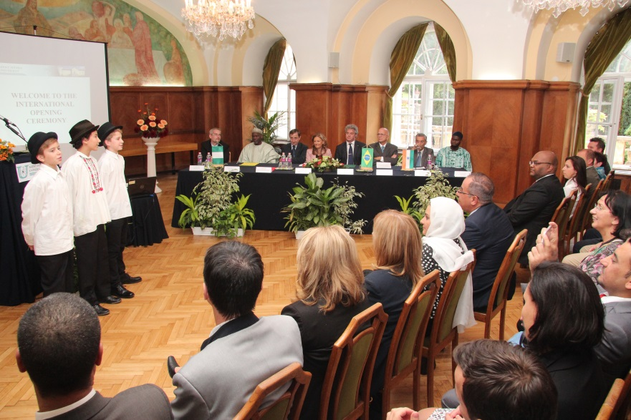
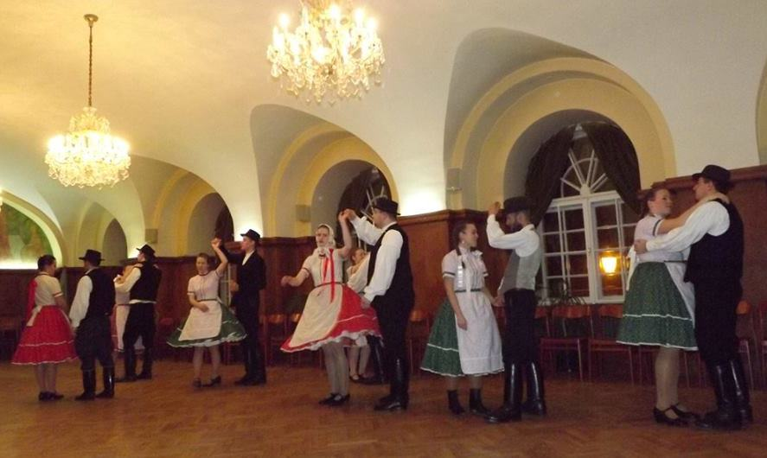
Programmes for international students
Orientation Week
Researcher’s Night
International Opening Ceremony
Cultural events (international dinner, Hungarian folkdance teaching, sports competitions etc.)
Hungarian language course is offered
Plant, farm visits
Participation on scientific conferences
Community garden in Gödöllő (grow your own veggies and herbs): https://www.facebook.com/SZIA-Agroecological-Garden-of-MATE-112538517117241/

