Slide 1

General information on doctoral studies
Gödöllő and Buda Campus
September, 2026

Slide 2


Main contacts
MATE, 2100 Gödöllő, Páter Károly utca 1. ,
Tel.: 06-28-522-000,
E-mail: phd@uni-mate.hu
AZ ELŐADÁS CÍME, KÉT SORBAN
OFFICE HOURS
Monday to Thursday
8:30-12:00
KÉSZÍTETTE: SAMPLE TAMÁS

Slide 3


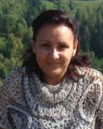
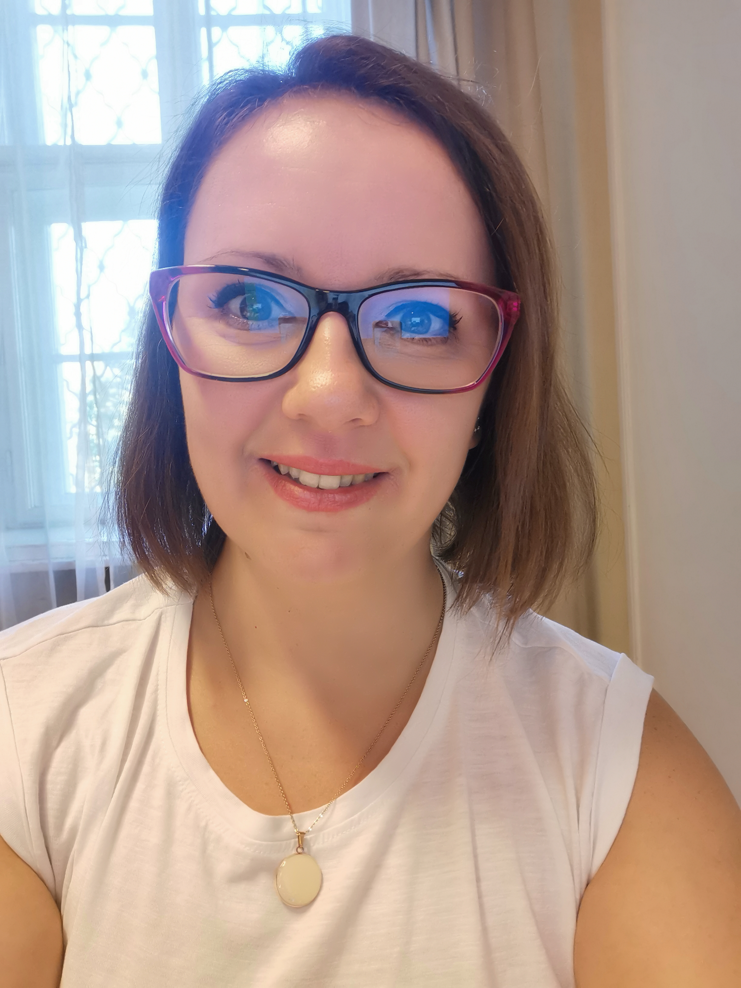
Administration: Who to contact (Gödöllő and Buda)?
Colleagues at DHC
Mónika Hajdú
Head of DHC
Doctoral and Habilitation Centre, Gödöllő
Edit Simáné Dolányi
International coordinator (educational)
Doctoral and Habilitation Centre, Gödöllő, Buda

Slide 4

Registrar’s office responsibility
Your Registrar’s Officer is responsible for:
Neptun administration: enrollment, subject and exam registration:
https://hallgato.uni-mate.hu/hallgato_ng/login
Neptun request (complex exam, final defense application, termination of student status, etc.)
Neptun E-Requests https://ed.uni-mate.hu/e-requests-in-neptun
Issuance of documents:
    Student Status Certificate
    Transcript of records
    Temporary Student ID
    Sticker for student ID
    Diploma

Slide 5
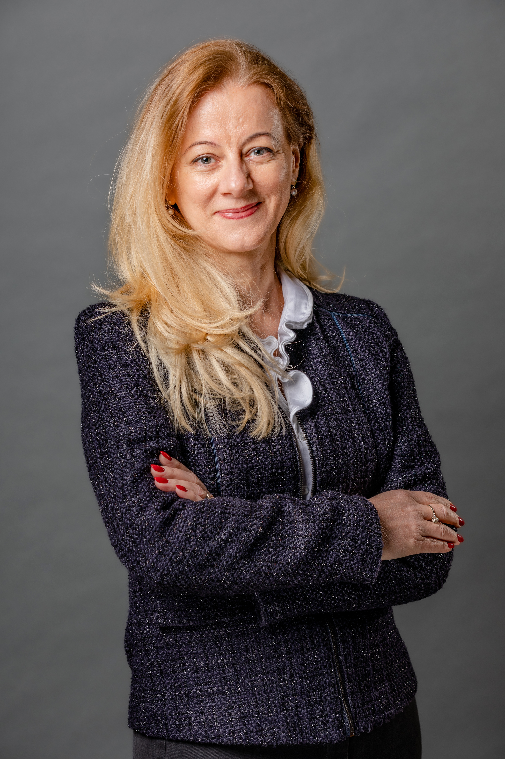
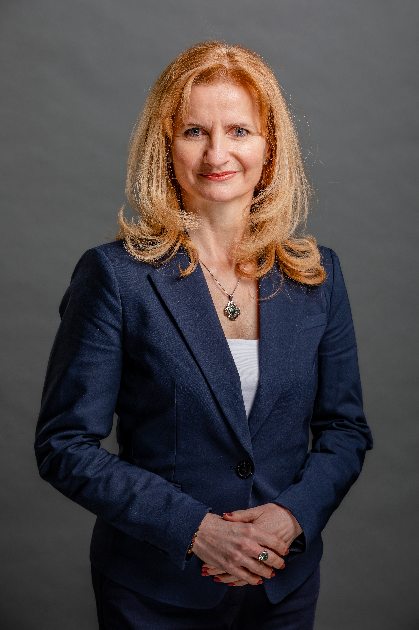
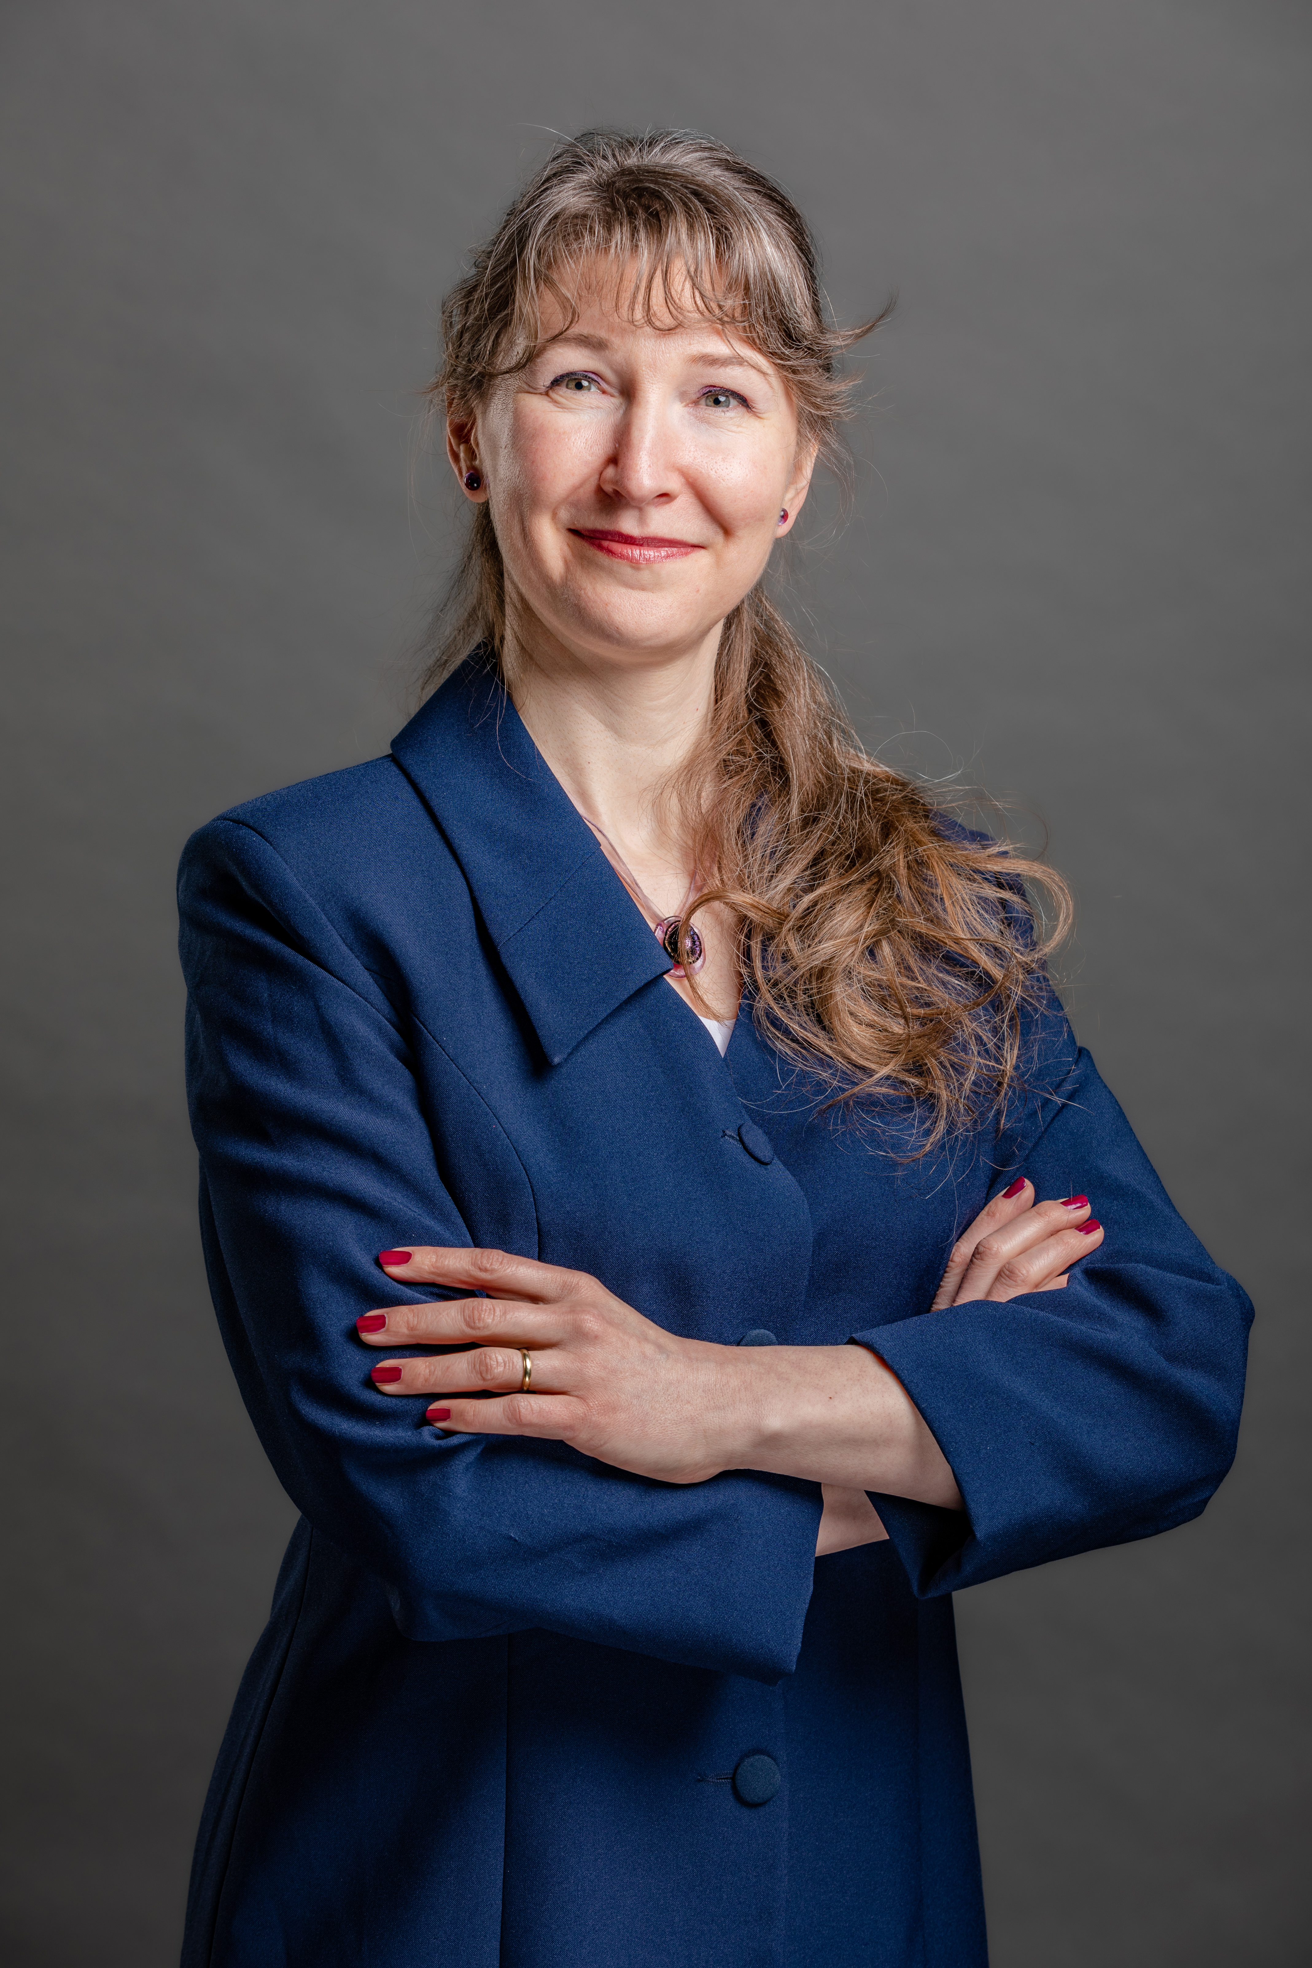
Colleagues at International Centre (IC)
Dr. Zsuzsanna Tarr
Head of Center for International Education
Csilla Kánai
Stipendium Hungaricum (SH) Institutional Coordinator
Judit Talláromné Czingili
Student Services Coordinator – non-educational issues (SH, SCYP, DFP, FAO, MISP, Self-finance)
Olga Tanninecz
International coordinator– non-educational issues (SH – Szent István Campus)

Slide 6

Center for International Relations responsibility
Scholarship Agreements (SH/FAO/Diaspora)
Residence Permit pick-up
Guidance:
    TAJ card application
    use of health insurance
    Request any change regarding scholarship status:
        Change of study program / language / host institute
        Extension
    Renewal of Residence Permit / TAJ card
Erasmus+ (Pannónia Scholarship) learning agreement, certificate of arrival, certificate of departure

Slide 7

Colleagues at Dormitory (Gödöllő and Buda)
Beáta Kárpáti
Student coordinator
Dormitory, Gödöllő
Ildikó Fedor
Head of Dormitory
Somogyi Imre Dormitory, Buda
https://kollegiumok.uni-mate.hu/

Slide 8
Our Doctoral Schools, Programs & Contact Persons
Doctoral School of Agricultural and Food Sciences
Head of DS: | Dr. Melinda Kovács, MHAS | Kovacs.Melinda@uni-mate.hu
Scientific coordinator of DS: | Dr. Júlia Halász, DSc | Halasz.Julia@uni-mate.hu
Animal Science Program Agricultural Sciences/Animal Sciences
Head of Program: | Dr. András Szabó, DSc | Szabo.Andras@uni-mate.hu
Scientific coordinator of Program: | Dr. Henrietta Nagyné Kiszlinger, PhD | Nagyne.Kiszlinger.Henrietta@uni-mate.hu
Food Science Program Agricultural Sciences/Food Sciences
Head of Program: | Dr. Gabriella Kiskó, PhD | Kisko.Gabriella@uni-mate.hu
Scientific coordinator of Program: | Dr. Krisztina Takács, PhD | Takacs.Krisztina@uni-mate.hu
Plant and Horticulture Program Agricultural Sciences/Crop and Horticulture Sciences
Head of Program: | Dr. Éva Zámboriné Németh, DSc | Zamborine.Nemeth.Eva@uni-mate.hu
Scientific coordinator of Program: (Horticulture Sc.) | Dr. Noémi Kappel, PhD | Kappel.Noemi@uni-mate.hu
Scientific coordinator of Program: (Plant Sc.) | Dr. Anikó Veres, PhD | Veres.Aniko@uni-mate.hu
Doctoral School of Natural Sciences
Head of DS: | Dr. Erika Csákiné Michéli, CMHAS | Micheli.Erika@uni-mate.hu
Scientific coordinator of DS: | Dr. Éva Várallyay, DSc | Varallyay.Eva@uni-mate.hu
Biological Science Program Natural Sciences/Biological Sciences
Head of Program: | Dr. Zoltán Nagy, DSc | Nagy.Zoltan@uni-mate.hu
Scientific coordinator of Program: | Dr. János Balogh, PhD | Balogh.Janos@uni-mate.hu
Environmental Science Program Natural Sciences/Environmental Sciences
Head of Program: | Dr. András Székács, DSc | Szekacs.Andras@uni-mate.hu
Scientific coordinator of Program: | Dr. Miklós Gulyás, PhD | Gulyas.Miklos@uni-mate.hu
Scientific coordinator for international students: | Dr. Mátyás Cserháti, PhD | Cserhati.Matyas@uni-mate.hu
Doctoral School of Economic and Regional Sciences
Head of DS: | Dr. Viktoria Szente, PhD | Szente.Viktoria@uni-mate.hu
Scientific coordinator of DS: | Dr. Kinga Szabó, PhD | Szabo.Kinga@uni-mate.hu
Scientific coordinator for international students: | Dr. Mária Farkasné Fekete, PhD | Farkasne.Fekete.Maria@uni-mate.hu
Sustainable Business and Management Program Social Sciences/Management and Business Administration Sciences
Head of Program: | Dr. Viktória Szente, PhD | Szente.Viktoria@uni-mate.hu
Scientific coordinator of Program: | Dr. Emese Prihoda, PhD | Prihoda.Emese@uni-mate.hu
Regional Economic Development and Management Program Social Sciences/Regional Sciences
Head of Program: | Dr. József Káposzta, CSc | Kaposzta.Jozsef@uni-mate.hu
Scientific coordinator of Program: | Dr. Kitti Némediné Kollár, PhD | Nemedine.Kollar.Kitti@uni-mate.hu
Doctoral Scool of Engineering
Head of DS: | Dr. László Bozó, MHAS | Bozo.Laszlo@uni-mate.hu
Scientific coordinator of DS: | Dr. Ágnes Sallay, PhD | Sallay.Agnes@uni-mate.hu
Mechanical Engineering Program Engineering Sciences/Engineering Sciences
Head of Program: | Dr. Gábor Kalácska, DSc | Kalacska.Gabor@uni-mate.hu
Scientific coordinator of Program: | Dr. István Seres, PhD | Seres.Istvan@uni-mate.hu
Landscape Architecture Program Engineering Sciences/Agricultural Engineering Sciences
Head of Program: | Dr. László Bozó, MHAS | Bozo.Laszlo@uni-mate.hu
Scientific coordinator of Program: | Dr. Ágnes Sallay, PhD | Sallay.Agnes@uni-mate.hu

Slide 9

Key sources of information
WEBSITES
REPORTING ERROR
In case of Neptun: neptun@uni-mate.hu
In case of E-learning: elearning@uni-mate.hu
In any other case: helpdesk@uni-mate.hu
https://en.uni-mate.hu/
https://phd.uni-mate.hu/
https://doktori.hu/
FACEBOOK
Join „International students at MATE (former SZIU)” and
„International PhD students MATE (former SZIU)” groups
RULES AND PROCEDURES
https://phd.uni-mate.hu/regulations

Slide 10
Key Information about PhD studies
Enrollment for doctoral training: https://ed.uni-mate.hu/registration-form
Request for student ID: https://ed.uni-mate.hu/student-id (next slide)
Subject registration in NEPTUN:
        Fall semester: 1st September - 31st December
        Spring semester: 1st February - 31st May
Application periods (complex exam, final defense): https://phd.uni-mate.hu/general-information

Slide 11
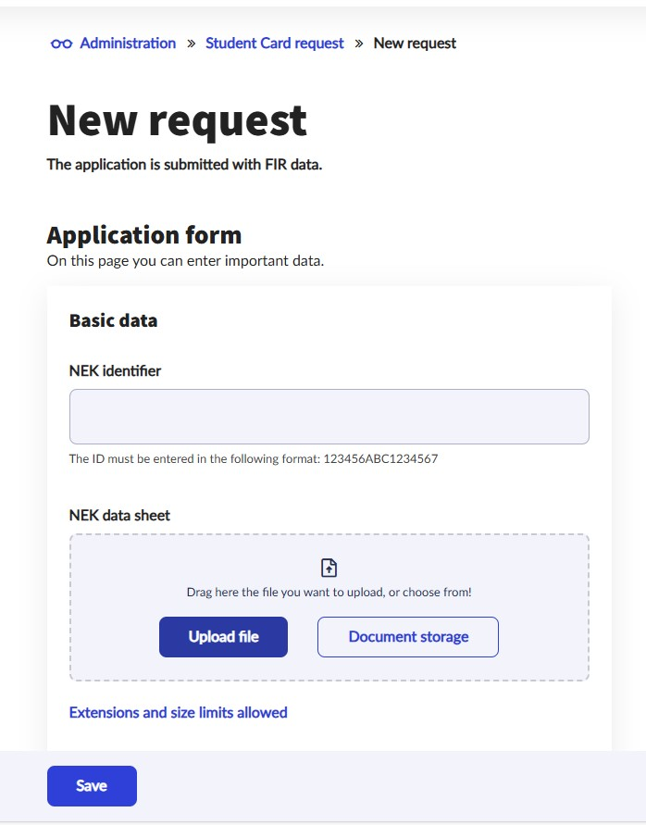

Student ID
Get Student Status Certificate (from Registrar’s office)
Go to Government’s Office: NEK data sheet-> NEK code (pic 1 ->).
      Required documents:
          Passport/ national ID
          student status certificate (in Hungarian!)
Upload NEK data sheet into Neptun (pic 2 ->)
Submit application in Neptun
Ask for Temporary Student ID

Slide 12
Structure of PhD programme
Year 1 | Study and reseach phase: Courses Literature review Research Development of final research work plan 90 credits
Year 2
Mid-term/Complex Exam – Application for Complex Exam via NEPTUN!
Year 3 | Research and dissertation phase: Research Publications 90 credits
Year 4
Final certificate – 180 credits (absolutorium) Home defense
Final defense – Application for final defense via NEPTUN!

Slide 13
Mid-term (Complex) exam
„theoretical exam part”
2 subjects, defined for the students
(usually from the list of courses)
„thesis related part”
Scholars have to report on the progress of literature review, and project planning and initial research activities
Registration required (via Neptun)
Supervisor’s recommendation necessary
It is a public event
Exam Committee: minimum 3 members
The chair is a professor
All members hold PhD degree
Supervisor present, but not member, does not vote
The 2 parts are evaluated individually
Evaluation: passed / fail
Descriptive assessment will be issued on the spot
Both parts have to be successful
The theorexam can be resit once. If the second resit fails the programme is terminated.

Slide 14
Terms of PhD degree
successful mid-term exam,
180 credits
obtaining the final certificate (absolutorium),
documentation of the independent scientific work according to the DS rules (publication)
Defending the results and thesis in a public discussion (defence)
Details about defense process is another PPT (link)

Slide 15
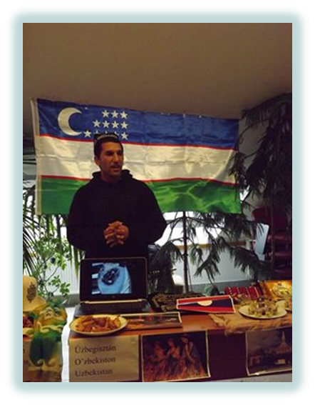
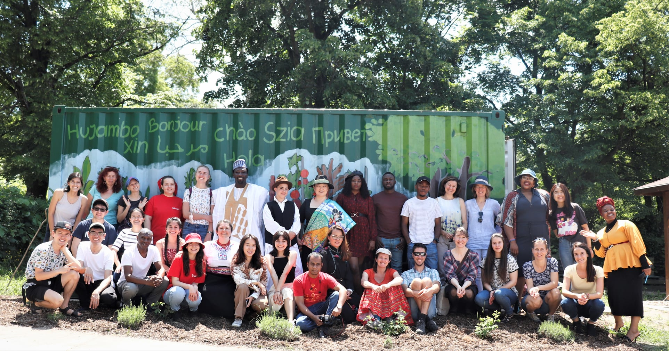
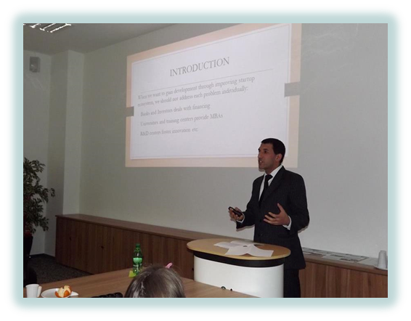
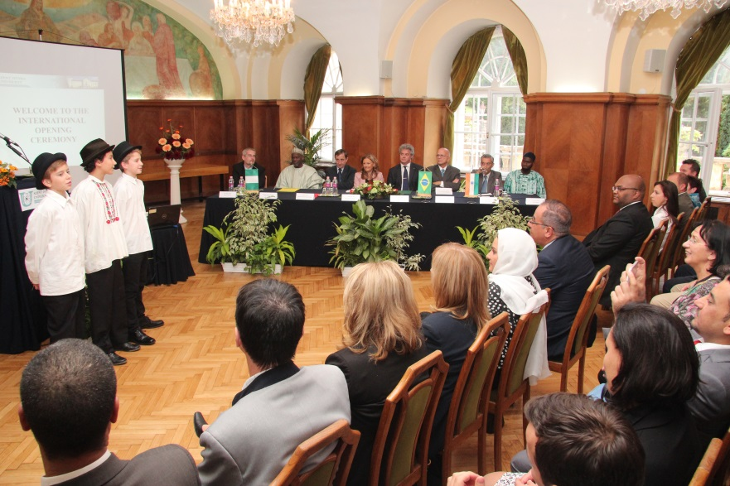
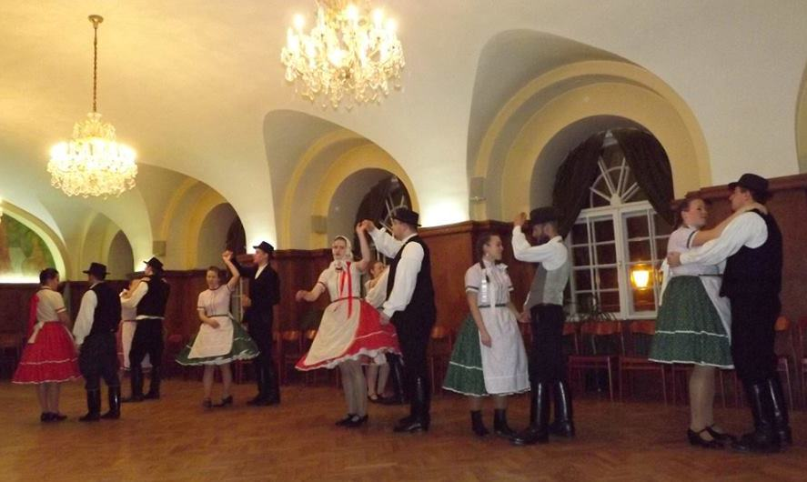
Programmes for international students
Orientation Week
Researcher’s Night
International Opening Ceremony
Cultural events (international dinner, Hungarian folkdance teaching, sports competitions etc.)
Hungarian language course is offered
Plant, farm visits
Participation on scientific conferences
Community garden in Gödöllő (grow your own veggies and herbs): https://www.facebook.com/SZIA-Agroecological-Garden-of-MATE-112538517117241/

